Slide 1

In Hospital Mortality Prediction
May 13, 2024
Vanderbilt Data Analytics Bootcamp
Project 4 - Team 1
Emily Bowers, Matt Flanagan, Luis Martinez
Notes:
Our project was on in-hospital mortality prediction. 2012 in-hospital patient mortality refers to the death of a patient that occurs during their stay in a hospital or healthcare facility. Understanding in-hospital patient mortality is crucial for healthcare providers, policymakers, and researchers. It helps identify areas for improvement in patient care, enhances patient safety, and informs healthcare policies.

Slide 2

Agenda
Project Overview & Purpose
Data Methods
Analysis
Key Learnings
Overview
Data Methods
Analysis
Key Learnings

Slide 3

Project Overview & Purpose
In Hospital Mortality Prediction
The factors that predict in-hospital mortality among patients with heart failure (HF) admitted to intensive care units (ICUs) are not well understood.
Our goal was to create and validate a model to predict all-cause in-hospital mortality for ICU-admitted HF patients.
Overview
Data Methods
Analysis
Key Learnings
Notes:
Our goal was to create and validate a model to predict all-cause in-hospital mortality for ICU-admitted HF patients. We aimed to create a model that could accurately identify high-risk patients, enabling healthcare providers to intervene proactively and optimize treatment strategies. By leveraging predictive modeling techniques, we can enhance clinical decision-making, improve patient outcomes, and ultimately save lives in critical care settings.

Slide 4
Key Points
All 4 models tested showed poor performance to predict inpatient mortality, though were strong at predicting True Negatives (predicted survival)
Majority of patients had only 2-3 comorbidities
Majority of the expired patients in dataset were overweight or obese
Overview
Data Methods
Analysis
Key Learnings
Notes:
We used four different models to predict inpatient mortality. The first was based solely on a patient's lab results, the second was based solely on their comorbidities, the third was based solely on their vital signs, the fourth and final model was based on a patient's lab results, comorbidities, and vital signs combined. All four models showed poor performance but were strong a predicting survival. It was found that most patients had around 2-3 comorbidities with the most common being high blood pressure, atrial fibrillation, and diabetes. One notable discovery was also that the majority of expired patients were obese or overweight.

Slide 5
Data Overview
Data Source: Kaggle dataset, originally from MIMIC-III database
About: In Hospital Mortality Prediction Dataset, Admissions to ICU of the Beth Israel Deaconess Medical Center, Boston, MA
Inpatient admissions from June 1, 2001 - October 31, 2012
Data Size: 1177 de-identified patients
49 Total Variables
Data Exploration & Preparation: Python, Pandas
Source: https://www.kaggle.com/datasets/saurabhshahane/in-hospital-mortality-prediction/data
Overview
Data Methods
Analysis
Key Learnings
Notes:
Our data was sourced from Kaggle.com from the Admissions to ICU of the Beth Israel Deaconess Medical Center, Boston, MA June 1, 2001-October 31
We had 1177 total rows with 49 different columns representing comorbidities, lab results, vital signs and more. To clean the data we utilized python and pandas

Slide 6
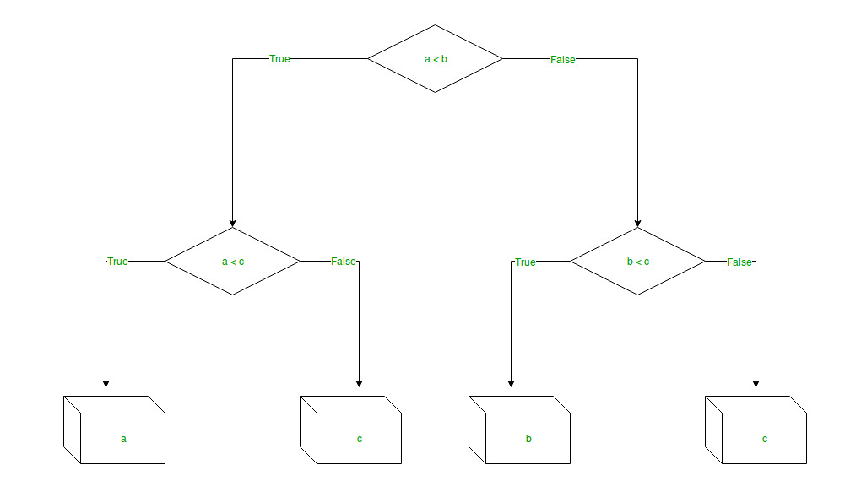
Data Methods - Model Selection & Training
Determined Groupings as Collective Variables for Testing:
Lab Values (n=30)
Vital Signs (n=6)
Comorbidities (n=9)
All Clinical Data Combined (N=45)
Decision Tree Model
Meta Analysis of Predicting Mortality among HF Patients:
https://www.ncbi.nlm.nih.gov/pmc/articles/PMC8065274/
Source:https://www.geeksforgeeks.org/python-decision-tree-regression-using-sklearn/?ref=lbp
Overview
Data Methods
Analysis
Key Learnings
Notes:
- Model Selection and Training:
- Exploratory Data Analysis We explored the dataset to understand the relationships between different variable groups (lab values, vital signs, comorbidities) and determined to use these groupings as collective variables for testing. We reviewed several research articles, and there were many overlapping variables used across these studies and our dataset.
Research papers published on studies where heart failure patient data was used to build models predicting all-cause mortality, many used either logistic regression, random forests or decision tree modeling. In these studies, the number of predictors used were between 8 and over 4200 variables.
https://www.ncbi.nlm.nih.gov/pmc/articles/PMC8065274/
-Classification Model: We chose a Decision tree model because the dataset consisted of non-linear data and the project required binary classification (expired or not expired). The dataset was split into training and testing sets utilizing standardScaler to ensure all features tested have the same scale. We did not utilize Stratified Sampling due to when we tested the model with stratified sampling, the accuracy and precision decreased. We tested 4 variable groups - lab values, vital signs, comorbidities, and all clinical data combined to determine which variable groups may be helpful in predicting inpatient mortality.
- Tools:Python, Pathlib, sklearn, matplotlib, seaborn
Parameters used to evaluate model performance were the confusion matrix, reporting accuracy, precision, recall and f-score

Slide 7
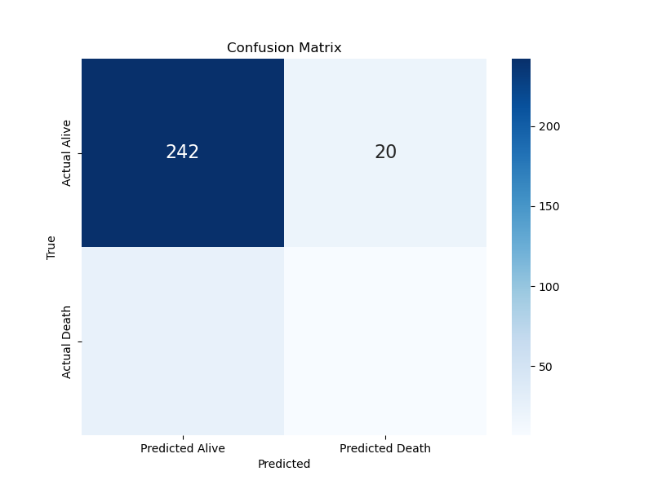
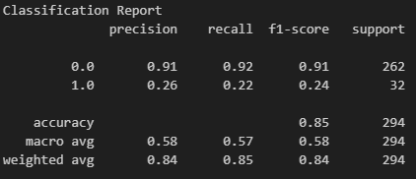
Interpretability
Lab Results Group:
Accuracy Score 84.6%
25
7
Overview
Data Methods
Analysis
Key Learnings
Notes:
Out of 262 patients predicted to be alive, 242 were correctly predicted, and 20 were incorrectly predicted as expired. Similarly, out of 32 patients predicted to be deceased, 7 were correctly predicted and 25 were incorrectly predicted as alive. The model is correct with its predictions about 85% of the time.
For the predictive positive cases, for the “alive” class its around 91% and for the “expired” class its around 26%. Overall, this model seems better at predicting patients’ status when they are alive, as indicated by the higher precision, recall and F1-score for the “alive” class

Slide 8
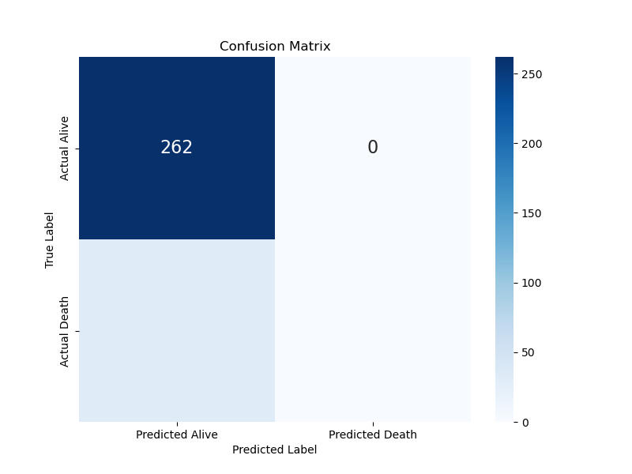
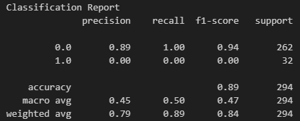
Interpretability
Comorbidity Group:
Accuracy Score 89.1%
32
0
Overview
Data Methods
Analysis
Key Learnings
Notes:
This model based on comorbidity status of 9 different comorbidities, it predicted all patients to be alive and none as expired regardless of the actual outcome.
This model is correct about 89% of the time as noted by the accuracy score
Precision for the expired class is 0%, indicating that none of the predicted death cases were correct. While the accuracy score seems high, the model’s inability to predict any deceased patients significantly affects its usefulness.

Slide 9
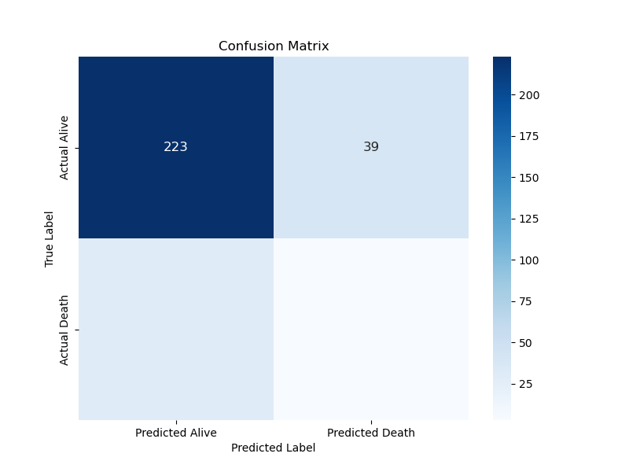
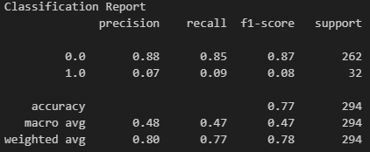
Interpretability
Vital Signs Group:
Accuracy Score 76.8%
29
3
Overview
Data Methods
Analysis
Key Learnings
Notes:
This model predicted 223 patients as alive correctly, but it wrongly predicted 39 alive patients as deceased. And on the flip side, it correctly predicted only 3 expired patients, but it wrongly classified 29 expired patients as alive. The accuracy score is roughly 77%, less than the other 2 models.
The precision score for the “alive” class is 88%, meaning 88% of the predicted alive cases were actually alive. Precision for the expired class was only 7%. Recall results were similar for both classes.
This model has a decent accuracy score, but its performance in correctly identifying expired patients is quite poor.

Slide 10

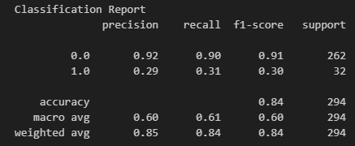
Interpretability
All Clinical Data Combined:
Accuracy Score 84.0%
22
10
Overview
Data Methods
Analysis
Key Learnings
Notes:
This model correctly predicted 237 patients as alive and 10 patients as expired. However, it incorrectly predicted 25 alive patients as expired and 22 expired patients as alive.
The accuracy score is around 84%, meaning the model is correct about 84% of the time. Precision for the expired class is 29%, meaning 29% of the predicted deceased cases were actually deceased. Recall for the expired class is 31% indicating that the model identified 31% of the actual deceased cases, which was the highest out of the 4 variable groups tested.
In summary, this model has a good accuracy score, but like the others, it struggles more with correctly identifying deceased patients but was the best model to do this out of the 4 tested.

Slide 11
Descriptive Data
Overview
Data Methods
Analysis
Key Learnings

Slide 12
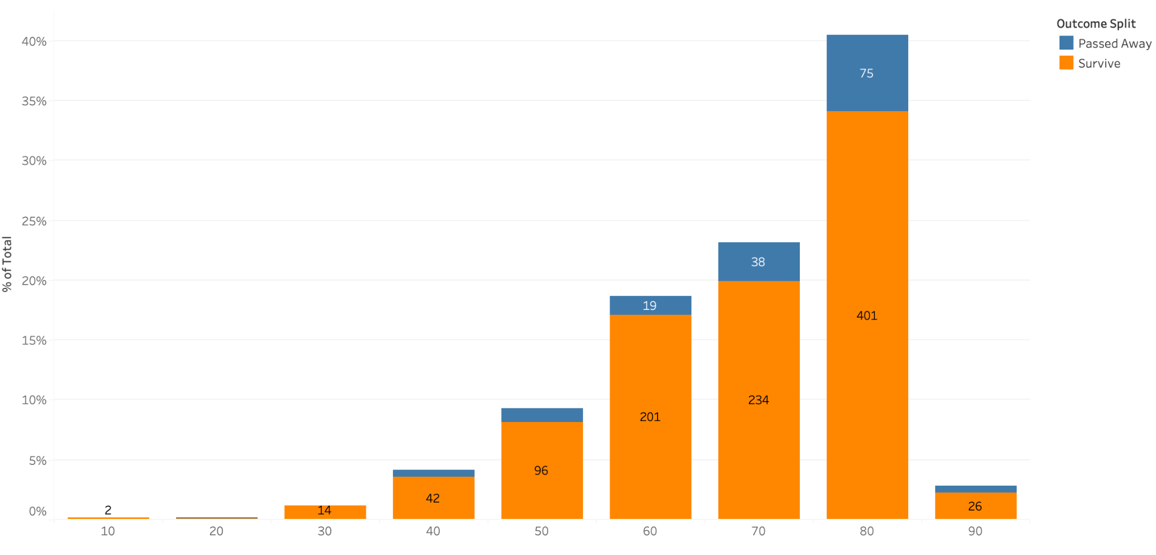
Age Distribution of Admitted Patients
Overview
Data Methods
Analysis
Key Learnings
Notes:
40% (476 patients) are between 80 - 90 years old
23% (272 patients) are between 70 - 80 years old
19% (220 patients) are between 60 - 70 years old
9% (109 patients) are between 50 -60 years old
4% (49 patients) are between 40 - 50 years old
3% (33 patients) are 90 + years old
1% (14 patients) are between 30 - 40 years old

Slide 13
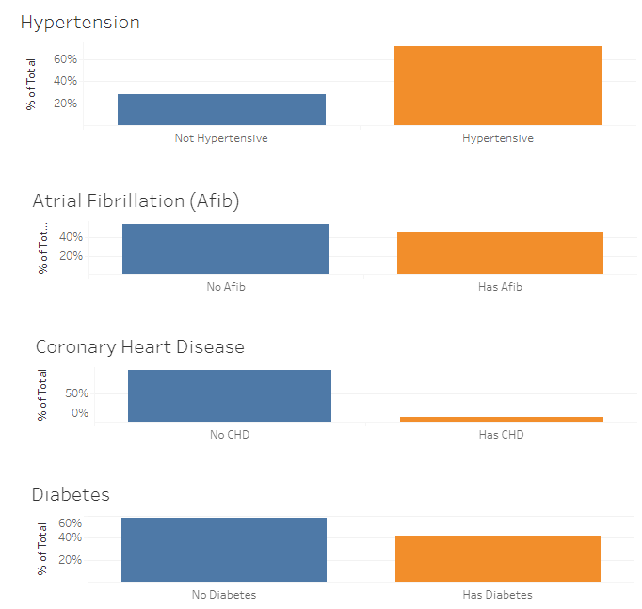
Comorbidities
~72% (845 patients) were Hypertensive
~45% (531 patients) had Atrial Fibrillation
~42% (493 patients) had Diabetes
The least common comorbidities were
COPD
Depression
Anemia
Coronary Heart Disease
Overview
Data Methods
Analysis
Key Learnings

Slide 14
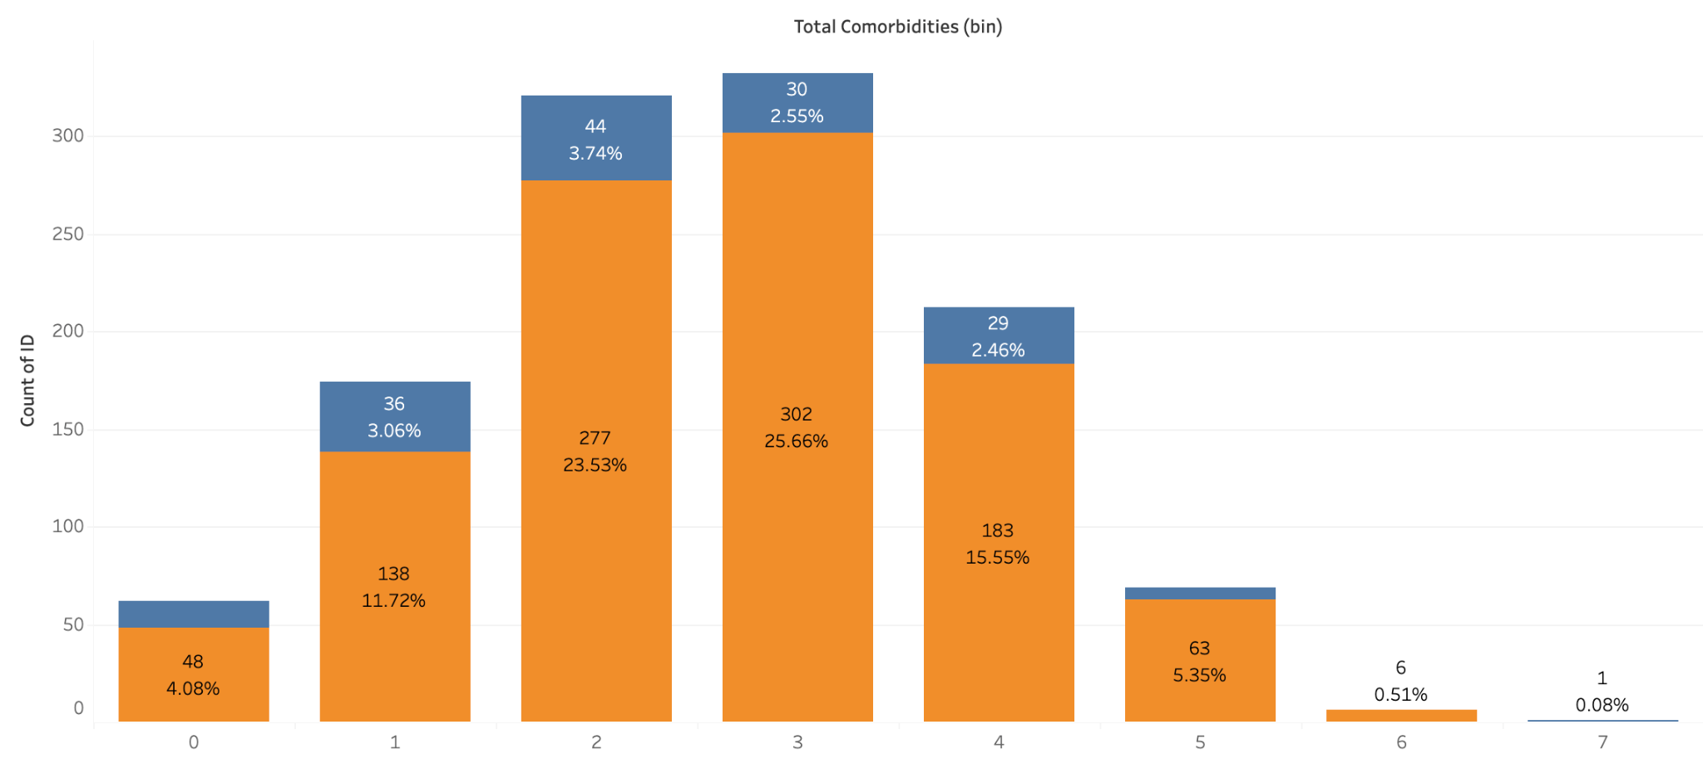

Total Comorbidities Per Patient
Overview
Data Methods
Analysis
Key Learnings
Notes:
Over half of all patients had 2 to 3 comorbidities each

Slide 15
Body Mass Index (BMI)
52% of patients were obese (613 patients)
23% of Males were obese (270 Males)
29% of Females were obese (343 Females)
24% of patients were overweight (285 Patients)
13% of Males were overweight (157 Males)
11% of Females were overweight (128 Females)
21% of patients were a healthy weight (243 Patients)
10% of Males were a healthy weight (118 Males)
11% of Females were a healthy weight (125 Females)
2% of patients were underweight (25 Patients)
0.5% of Males were underweight (7 Males)
1.5% of Females were underweight (18 Females)
Overview
Data Methods
Analysis
Key Learnings

Slide 16
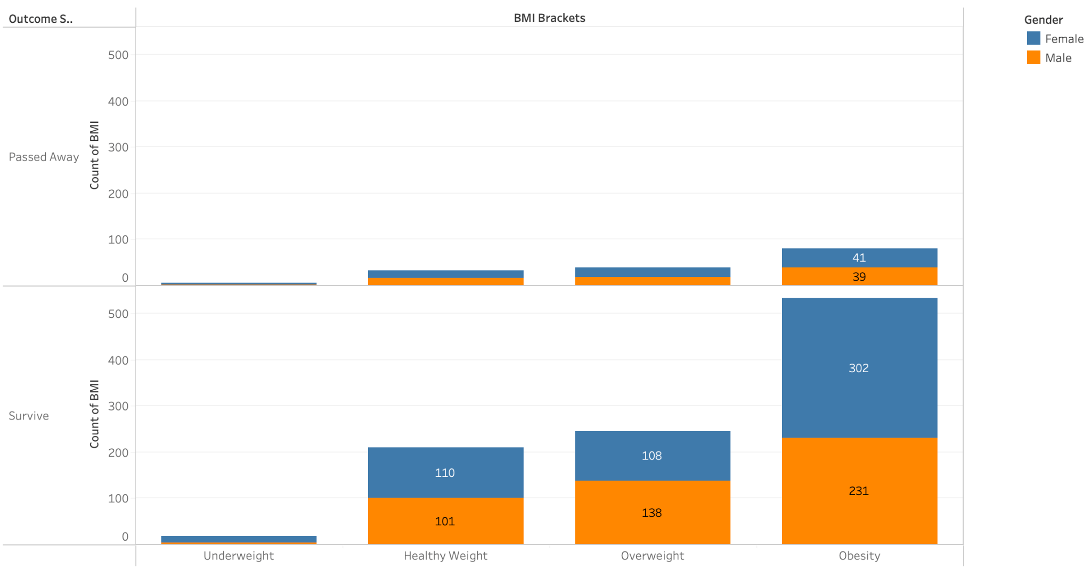
Outcome Per Gender by BMI
Overview
Data Methods
Analysis
Key Learnings

Slide 17
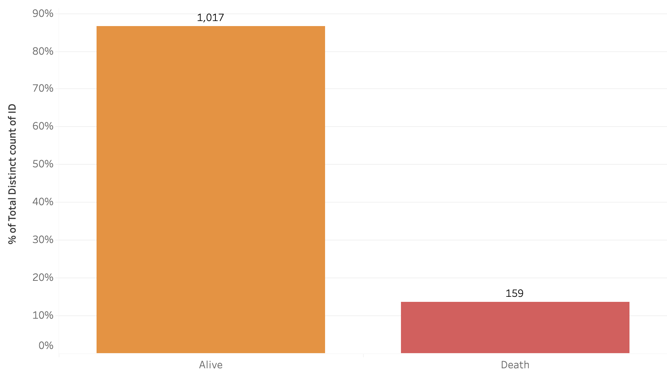
Outcome of Patients
Overview
Data Methods
Analysis
Key Learnings
Notes:
Roughly 7% of the patients in the dataset expired during inpatient stay.

Slide 18
Key Findings & Limitations
All 4 models tested showed poor performance to predict inpatient mortality, though were strong at predicting True Negatives (predicted survival)
Majority of patients had only 2-3 comorbidities, most common were Hypertensive (high Blood pressure), Atrial Fibrillation, and Diabetes.
Majority of the expired patients in dataset were overweight or obese (Body Mass Index BMI scores)
Limitations/Next Steps:
Standardize the test & training data sets using Stratified Sampling
Try different Supervised Learning models
Logistic Regression
Random Forest
Gradient Boosting Machines (GCM)
- Test different sets of variables
- Utilize more parameters to evaluate model performance (AUC)
- Healthcare data often has fewer positive observations/patterns for an algorithm to learn from
- Model outcomes only applicable to Hospital and its patient population
Overview
Data Methods
Analysis
Key Learnings
Notes:
In our analysis, all four models tested displayed inadequate performance in predicting inpatient mortality, although they exhibited strong capabilities in predicting true negatives, indicating survival. The majority of patients presented with only 2-3 comorbidities, with the most prevalent being hypertension, atrial fibrillation, and diabetes. Furthermore, a significant proportion of deceased patients in the dataset were categorized as overweight or obese based on their Body Mass Index (BMI) scores. Moving forward, our study suggests several limitations and avenues for future exploration. These include the need to standardize test and training datasets using Stratified Sampling and experimenting with different supervised learning models such as Logistic Regression, Random Forest, and Gradient Boosting Machines (GBM). Additionally, we propose testing different sets of variables and incorporating more parameters to evaluate model performance, particularly using the Area Under the Curve (AUC). It's crucial to note that the outcomes of our models are applicable solely to the specific hospital and its patient population under study.

